Slide 1
Creating Lightning Fast Apps Using AngularJS
By Ryan Schouten
SharePoint Saturday Redmond 2016

Slide 2





Ryan Schouten
Worked with SharePoint for > 9 years
I have experience with SharePoint 2003 – 2016
I have worked with ASP.Net for 15 years
MCPD, MCT, MCSE: SharePoint, MCSA: Office 365
Contact Information
Ryan@sharepointknight.com
@shrpntknight
http://www.sharepointknight.com

Slide 3

Office365 Implementations
Custom SharePoint Development
Responsive Design
Intranet Design/Implementations

Slide 4
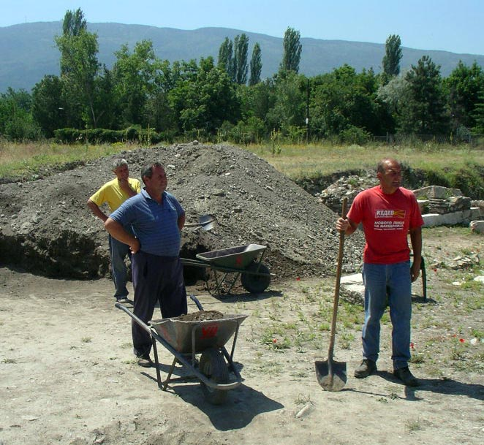
Agenda
AngularJS Basics
Controllers
Directives
Views
Data Binding
Filters
Adding it to SharePoint
Options for Getting Data
Lessons Learned

Slide 5

AngularJS
AngularJS History
Developed in 2009 to support a custom website
The site flopped and AngularJS was released as an open source library
Backed by Google
Follows MVC Pattern

Slide 6
Controllers
Handles interaction with the view and model
Contains most of your logic
Most of your time should be spent here

Slide 7
Directives
Allow for adding functionality to elements
AngularJS is full of directives
ng-controller, ng-class, ng-show, ng-repeat, etc.
Can be
HTML Tag
CSS class
Element Attribute

Slide 8
Views
This is your HTML markup
Minimal JavaScript

Slide 9
Data-Binding
AngularJS uses two-way data binding
Uses the handle bar notation in your view {{Title}}
Allows for easy interaction with the data without having to go find it.

Slide 10
Demo: {{DataBinding}}

Slide 11
Filters
Allow interaction with the data
Filters allow us to
Filter
Sort
Format
Create your own

Slide 12
SharePoint
Ways of Getting Data from SharePoint
REST
CSOM
Web Services
Know the limitations of each and choose what works for your needs

Slide 13
Demo: SharePoint Data and Filtering

Slide 14

Lessons Learned
Stay in Angular
ApplyAsync
Use ng-cloak
Be Mindful of scope
Promises
Don’t be afraid to use libraries where needed.
Be Mindful of the Digest Token
Be Careful with Angular boostrapping
Use Web Essentials tools for Visual Studio

Slide 15

Questions

Slide 16
Resources
AngularJS - https://www.angularjs.org/
AnuglarSP - http://angularsp.codeplex.com/
GitHub - https://github.com/sharepointknight/SharePointSaturday

Slide 17
Thanks
Thank your for attending Sharepoint Saturday Redmond 2016
Contact Information
Ryan@sharepointknight.com
@shrpntknight
http://www.sharepointknight.com

